Slide 1

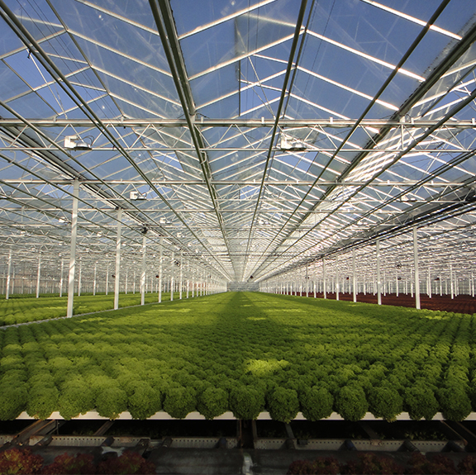
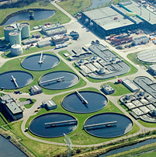

Model Predictive Control of Lettuce Greenhouse
Xiaodong Cheng, Assistant Professor, (xiaodong.cheng@wur.nl)
Mathematical and statistical methods group, Wageningen University

Slide 2
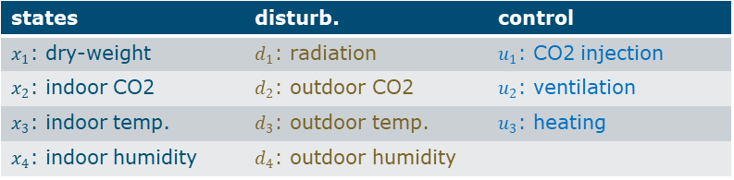
states | disturb. | control
$x_{1}$: dry-weight | $d_{1}$: radiation | $u_{1}$: CO2 injection
$x_{2}$: indoor CO2 | $d_{2}$: outdoor CO2 | $u_{2}$: ventilation
$x_{3}$: indoor temp. | $d_{3}$: outdoor temp. | $u_{3}$: heating
$x_{4}$: indoor humidity | $d_{4}$: outdoor humidity

Slide 3
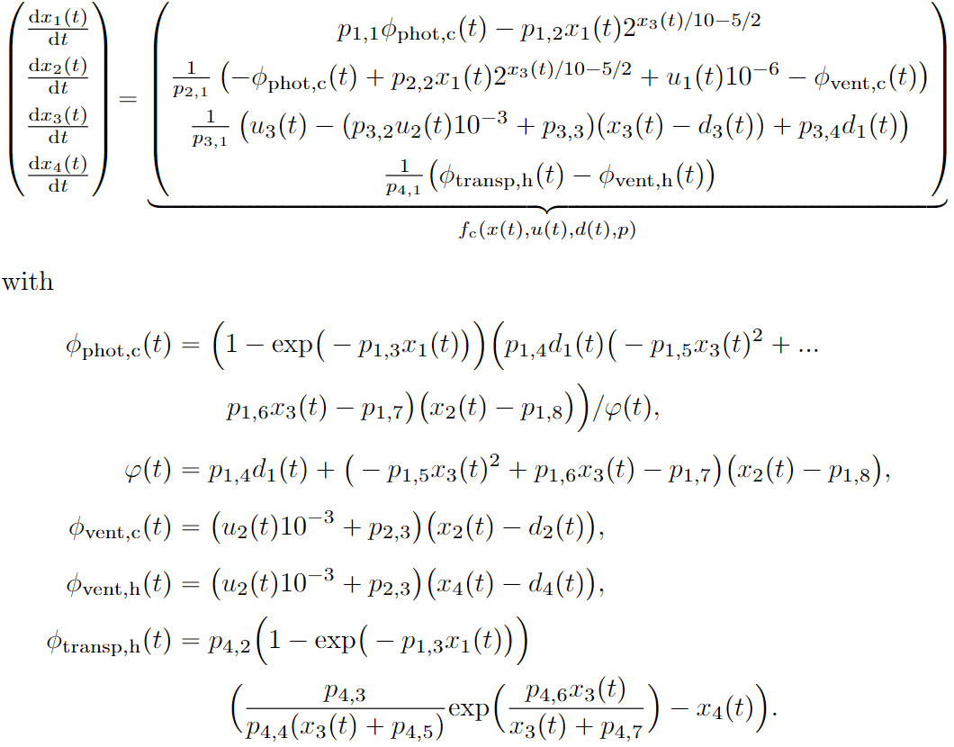
Greenhouse Model
Change of dry weight:
Weight gain from photosynthesis – weight loss due to respiration

Slide 4
Greenhouse Model
Change of indoor CO₂ concentration:
– Consumption of photosynthesis + increase due to respiration
+ CO2 injection – the mass exchange of CO₂ through the vents
Ventilation
difference in CO₂ concentration between indoor and outdoor

Slide 5
Greenhouse Model
Change of indoor temperature:
– heating + heat loss through the vents + heat gain from radiation

Slide 6
Greenhouse Model
Change of indoor humidity:
+ the canopy transpiration – exchange of H₂O through the vents
Determined by ventilation rate and humidity difference
affected by biomass, indoor temperature and humidity

Slide 7
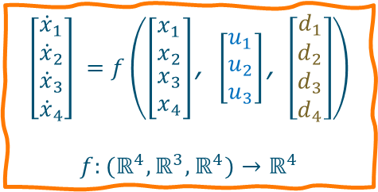
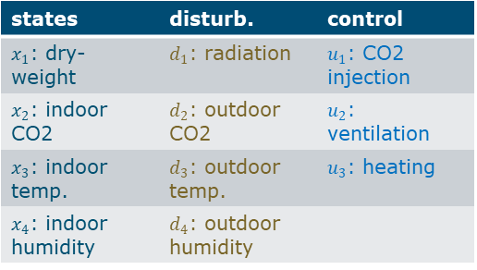
Greenhouse Model
states | disturb. | control
$x_{1}$: dry-weight | $d_{1}$: radiation | $u_{1}$: CO2 injection
$x_{2}$: indoor CO2 | $d_{2}$: outdoor CO2 | $u_{2}$: ventilation
$x_{3}$: indoor temp. | $d_{3}$: outdoor temp. | $u_{3}$: heating
$x_{4}$: indoor humidity | $d_{4}$: outdoor humidity
$$\left[\begin{matrix}{\dot{x}}_{1} \\ {\dot{x}}_{2} \\ \begin{matrix}{\dot{x}}_{3} \\ {\dot{x}}_{4}\end{matrix}\end{matrix}\right] =f\left(\left[\begin{matrix}x_{1} \\ x_{2} \\ \begin{matrix}x_{3} \\ x_{4}\end{matrix}\end{matrix}\right]\text{, }\left[\begin{matrix}u_{1} \\ u_{2} \\ u_{3}\end{matrix}\right]\text{, }\left[\begin{matrix}d_{1} \\ d_{2} \\ \begin{matrix}d_{3} \\ d_{4}\end{matrix}\end{matrix}\right]\right)$$
$$f:(ℝ^{4},ℝ^{3},ℝ^{4})→ℝ^{4}$$

Slide 8
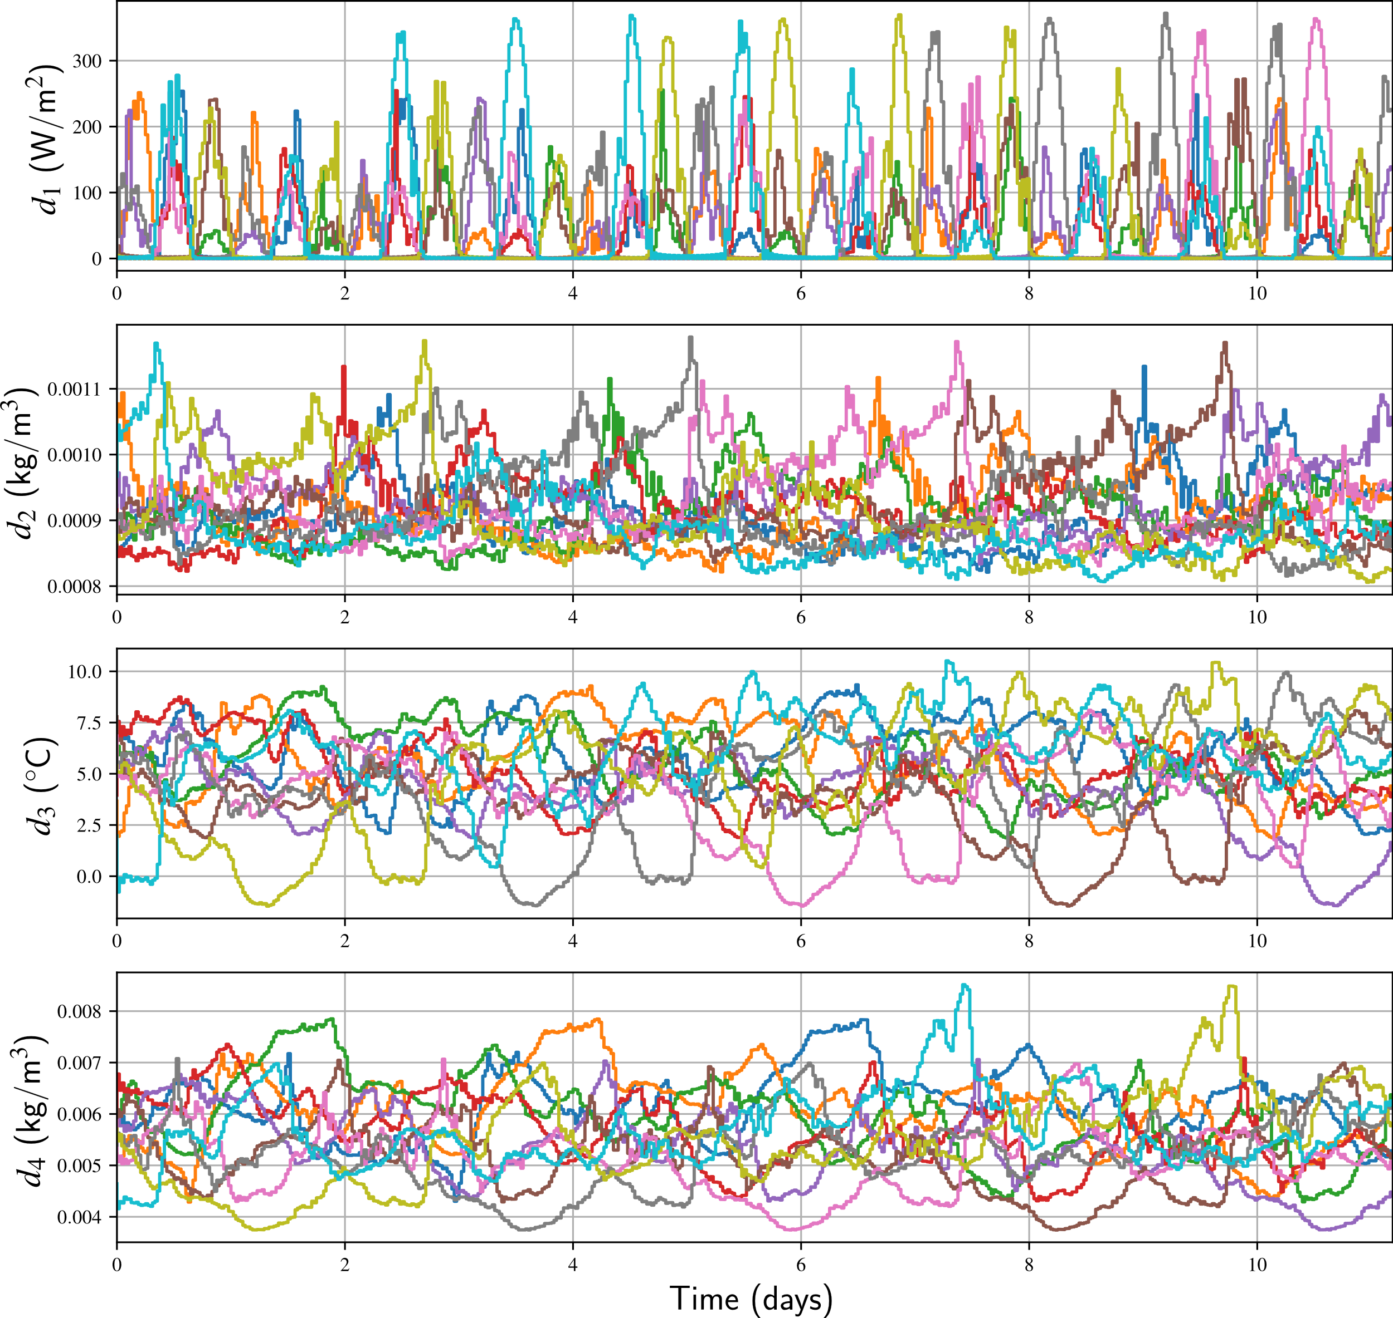
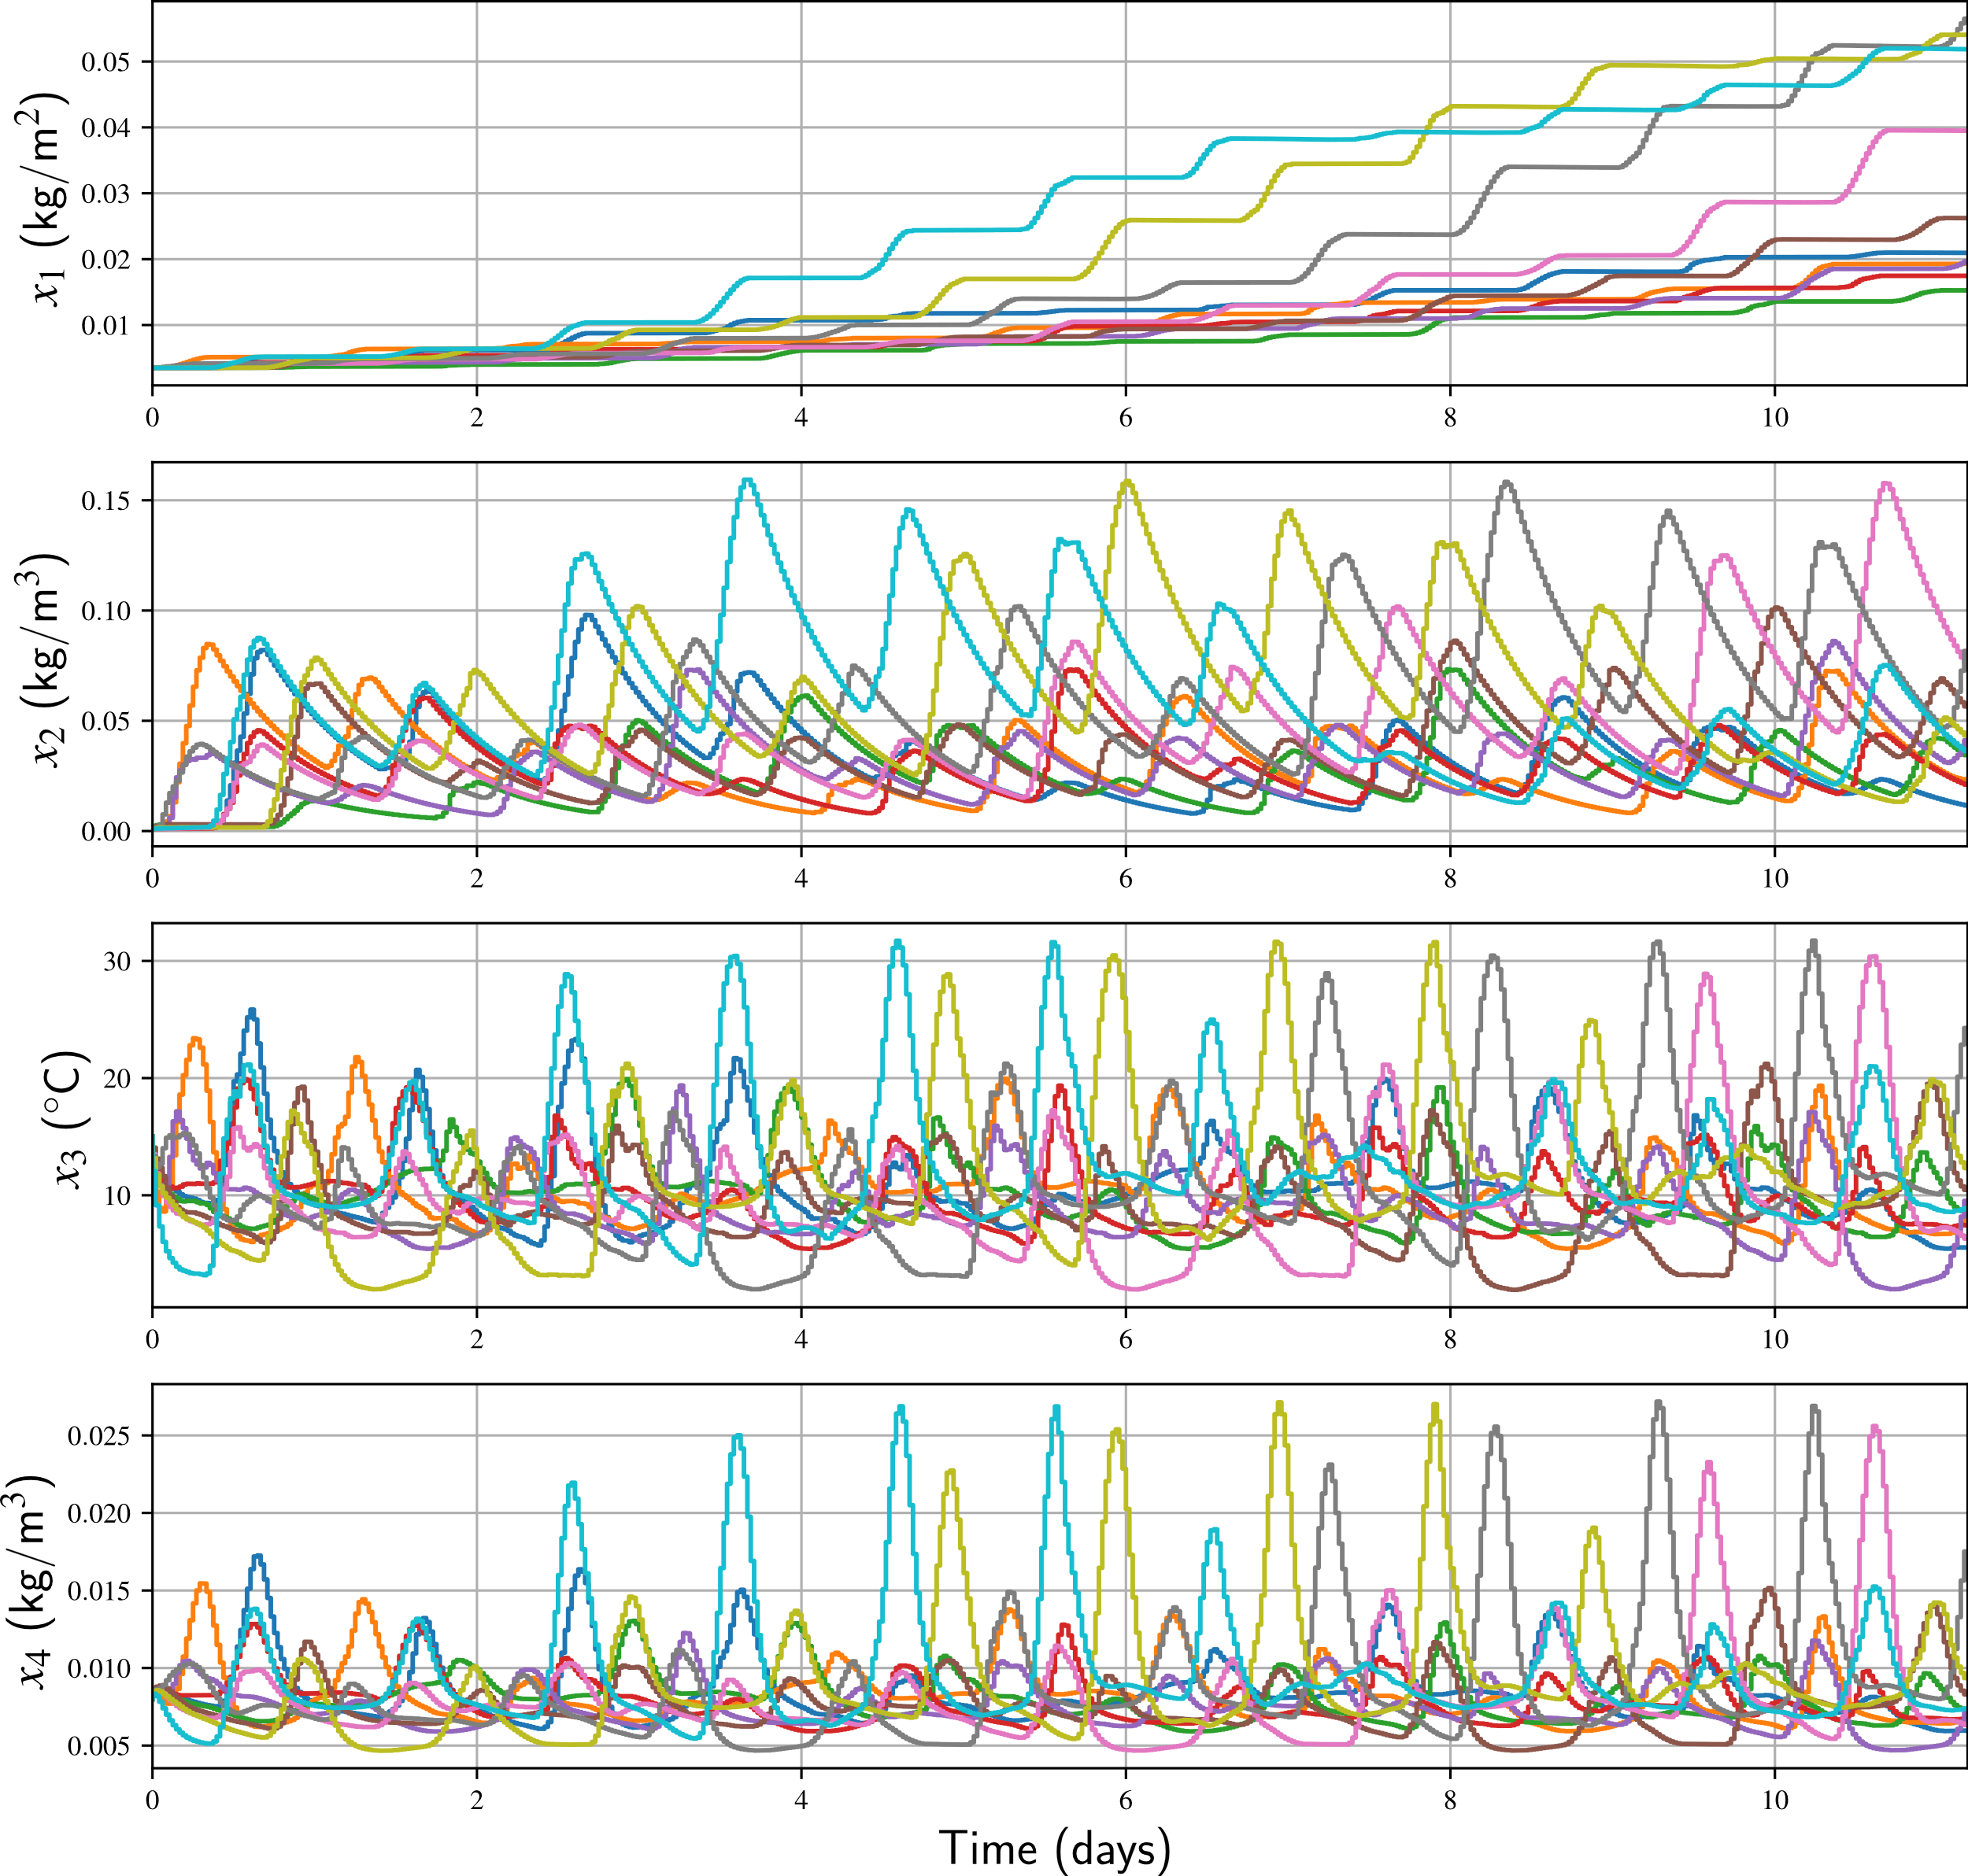
@ Bleiswijk, Netherlands

Slide 9
Preparation
Go to: https://github.com/xcheng20/Greenhouse_Control_Exercise
Download all the files in the repository
Open ‘exercise_student_version.ipynb’ in python notebook
Install casadi
pip install casadi (needs pip -V>=8.1)

Slide 10
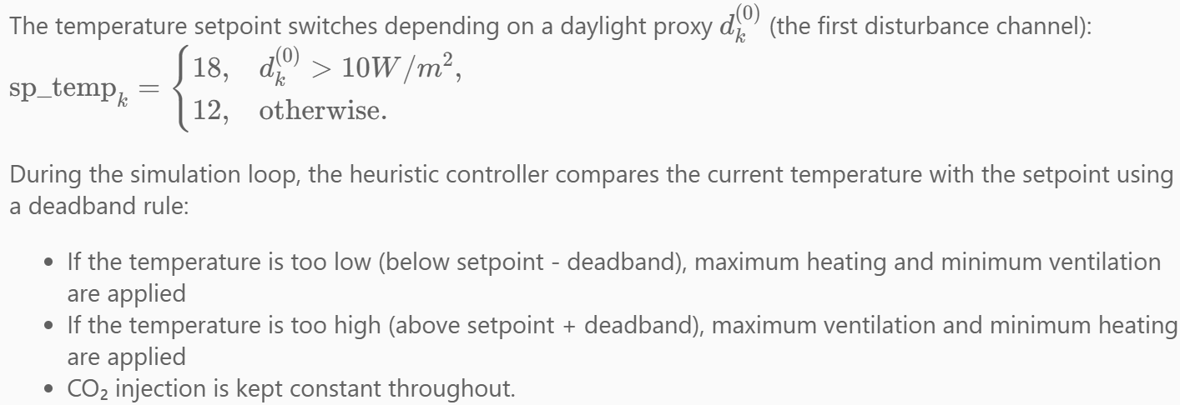
Task 1: Heuristic Feedforward Controller

Slide 11
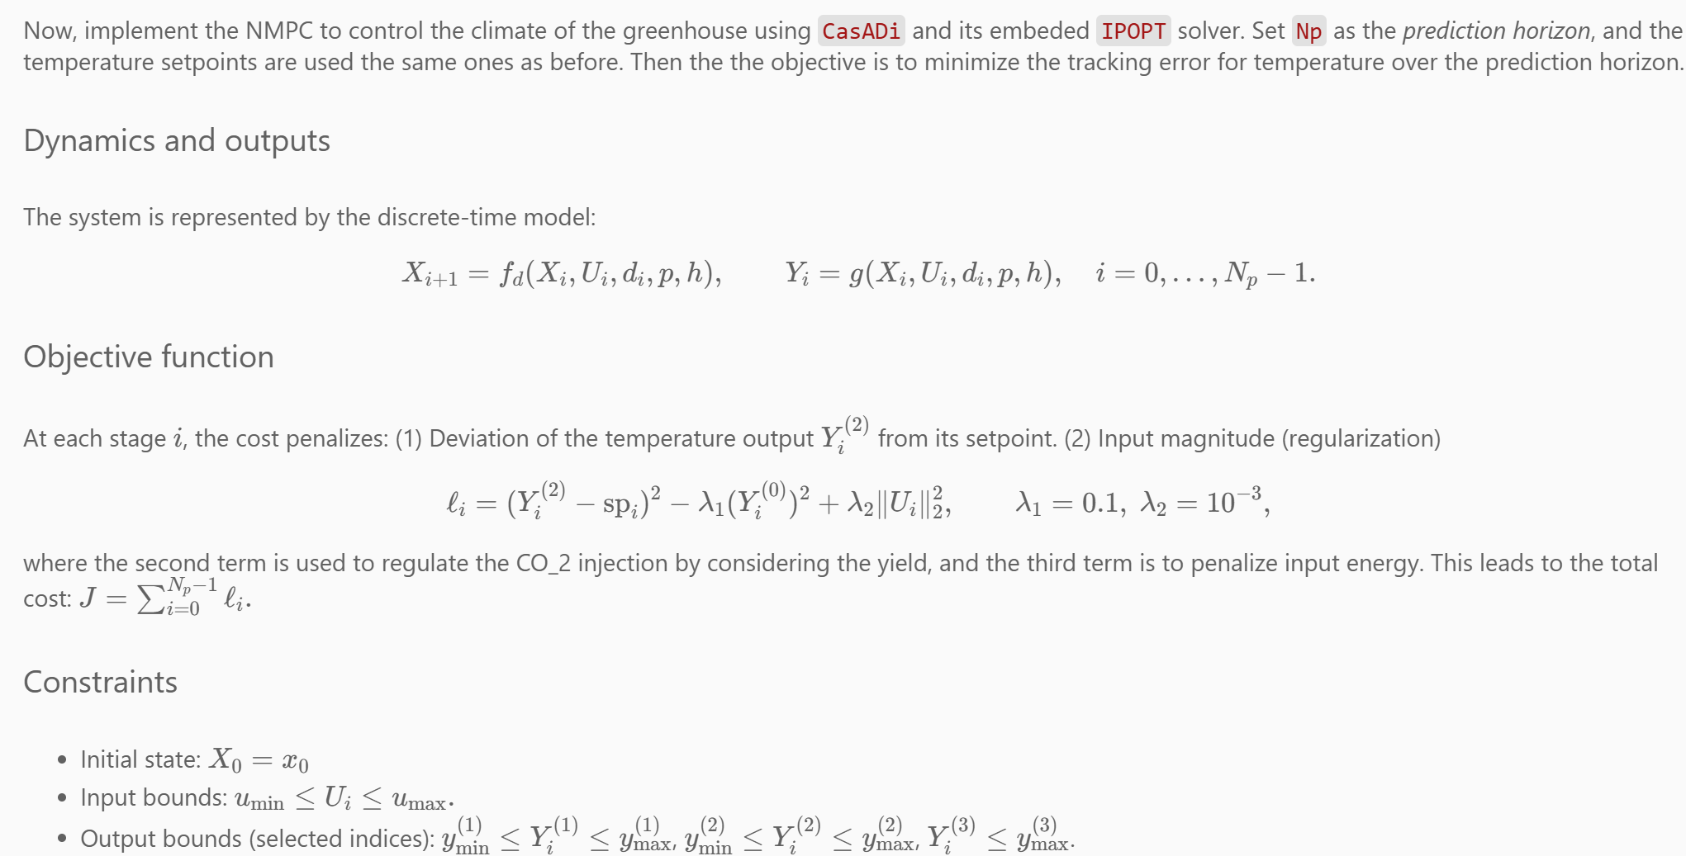
Task 2: MPC Controller

